Slide 1


INCIDENCE OF DIABETES AND OTHER CHRONIC DISEASES
Community Service Project

Slide 2
Contents
Brief description of the activity
Overview | Executive Summary
Introduction to CSP | We discusse the needs and importance of community service project
Introduction to Diabetes | Understanding Diabetes Which contains Symptoms and Types also with Prevention strategies
Introduction to Chronic Diseases | Understanding Chronic diseases Which contains Symptoms and Types also with Prevention strategies
Health screening | Life style Modification
From: PAVANI | NEHA| SANDHYA|NAVEEN|VARMA
Under the guidance of: Mrs. HIMA BINDU | ASSOCIATIVE PROFESSOR| DEPARTMENT OF CSE

Slide 3

OVERVIEW
Description of the Community:
The community service project focuses on addressing the rising incidence of diabetes and other chronic diseases in the local community. The target population comprises individuals residing in urban and suburban areas, predominantly characterized by low to middle-income households.
Summary of Activities:
1.Survey conducted in the village
2.Conduct Community awareness
3. Nutrition and Physical Activity Workshops
4. Healthy workshop

Slide 4
INTRODUCTION
The objectives is emphasizing the importance of addressing this health issue within the community.
a comprehensive discussion took place regarding the needs and significance of addressing the incidence of diabetes and other chronic diseases in the community.
The participants decided to focus on direct service, meaning they would addressing diabetes and chronic diseases were explored. In the form of exploring we decided to take survey in Krishnaraypuram(v), Pendurthi(M).
We went to Krishnaraypuram(v), Pendurthi(M) village head and also sachivalayam head we took permission to take survey in their village in order to form of community services
Tracing Issues Faced by People:
1. Lack of awareness about diabetes and chronic diseases.
2. Limited access to healthcare facilities and resources.
3. Inadequate knowledge about prevention, early detection, and management strategies.
4. Unhealthy lifestyle choices, including poor diet and lack of physical activity.

Slide 5
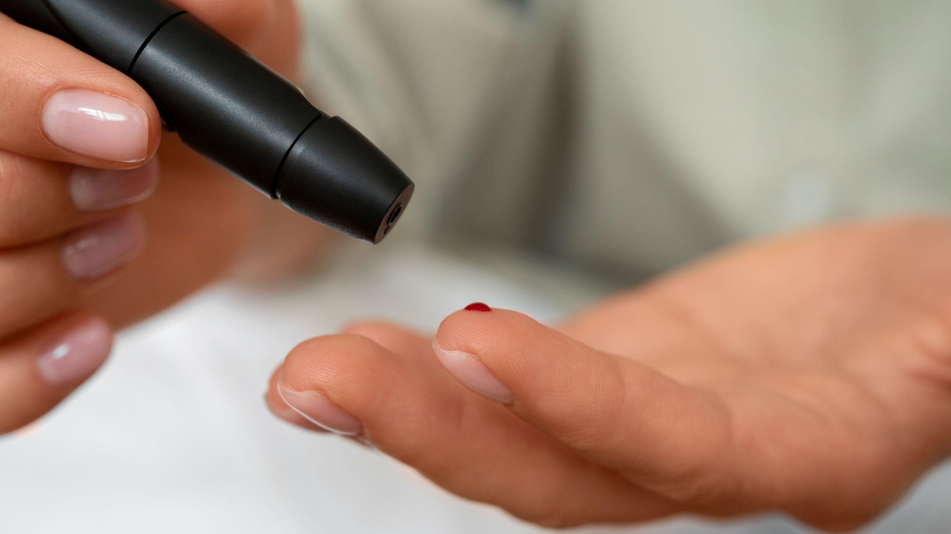
DIABETES
Diabetes is a chronic medical condition that affects how your body regulates blood sugar, also known as glucose. Glucose is a crucial source of energy for the cells in your body, and insulin,produced by pancreas.

Slide 6
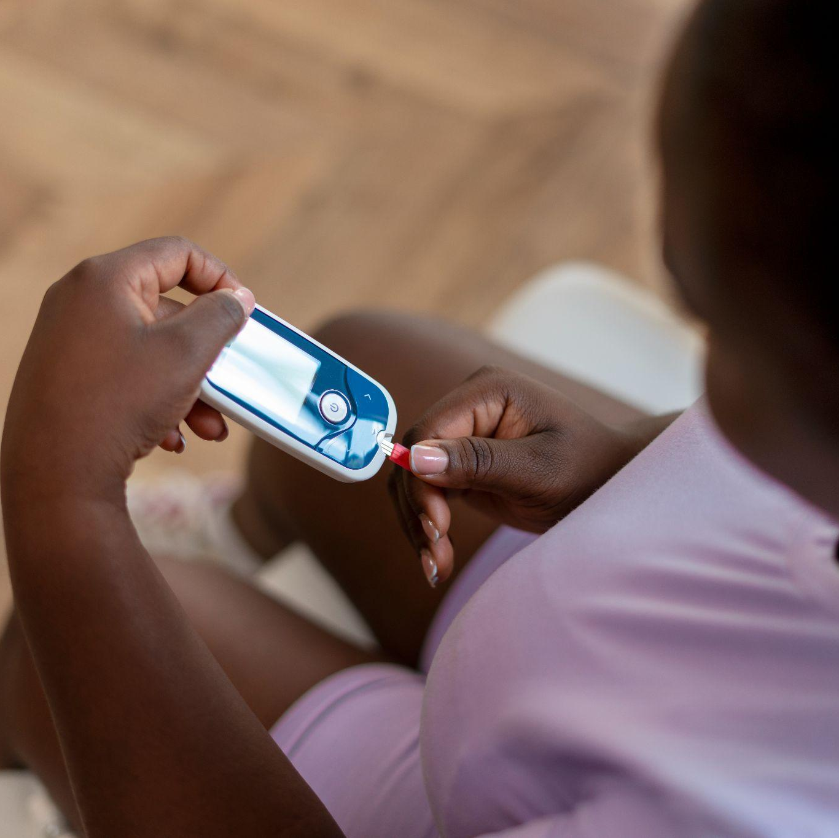
Understanding Diabetes Which contains Symptoms and Types
Symptoms of Diabetes: - Frequent urination
- Excessive thirst
- weight loss
- Increased hunger
- Fatigue
Types Of Diabetes:
-Type1, Type2
-Gestational diabetes
-Pre-diabetes
-Mody diabetes

Slide 7



Diabetes Prevention Strategies
Nutrition
Exercisce
Weight balance
Meals with moderate portions of carbs, lean protein, and healthy fats. Limit added sugars and processed foods to manage blood sugar levels effectively.
Aim for at least 150 minutes of moderate-intensity exercise per week, like brisk walking or cycling.
Maintaining a healthy weight through balanced diet and regular exercise is crucial for managing diabetes and preventing complications.

Slide 8
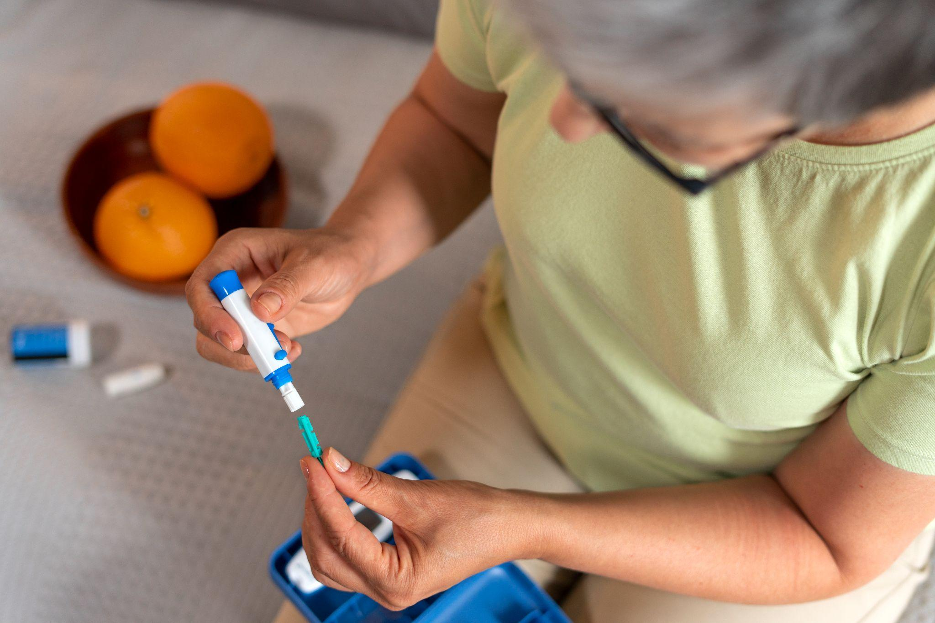
CHRONIC DISEASES
Chronic diseases are long-term medical conditions that typically progress slowly and persist over an extended period, often lasting for years or even a lifetime.

Slide 9

Understanding Chronic Diseases Which contains Symptoms and Types
Types of Chronic Diseases
- Cardiovascular
-Respiratory
-Diabetes
-Cancer
Symptoms of Chronic
- Frequent urination
- Excessive thirst
- weight loss
- Increased hunger
- Fatigue

Slide 10

Chronic Prevention Strategies
1. Nutrition
2. Exercisce
3. Weight Balance
Engaging in regular exercise, maintaining a balanced diet, getting enough sleep, seeking therapy or counseling, developing coping mechanisms, and maintaining a strong support network are crucial for managing mental health conditions .

Slide 11

Life Style Modifications
These sessions focused on educating participants about the importance of physical activity, balanced nutrition, stress management, and smoking cessation. Practical demonstrations, group activities, and expert-led discussions were used to encourage behavior change and empower individuals to adopt healthier habits.
Health

Slide 12
Thanks! From Our Team
G. NEHA
21981A4416
G. PAVANI
21981A4420
B. SANDHYA
21981A4405
G. NAVEEN
21981A4418
J. SAI HANEESH VARMA
21981A4422

